Slide 1
练习题

Slide 2
1.
Solve the ODE, , with zero initial conditions. Using Laplace transforms, partial fraction expansion and inverse Laplace transforms.

Slide 3
2. Using final value theorem to find for
Solution:

Slide 4
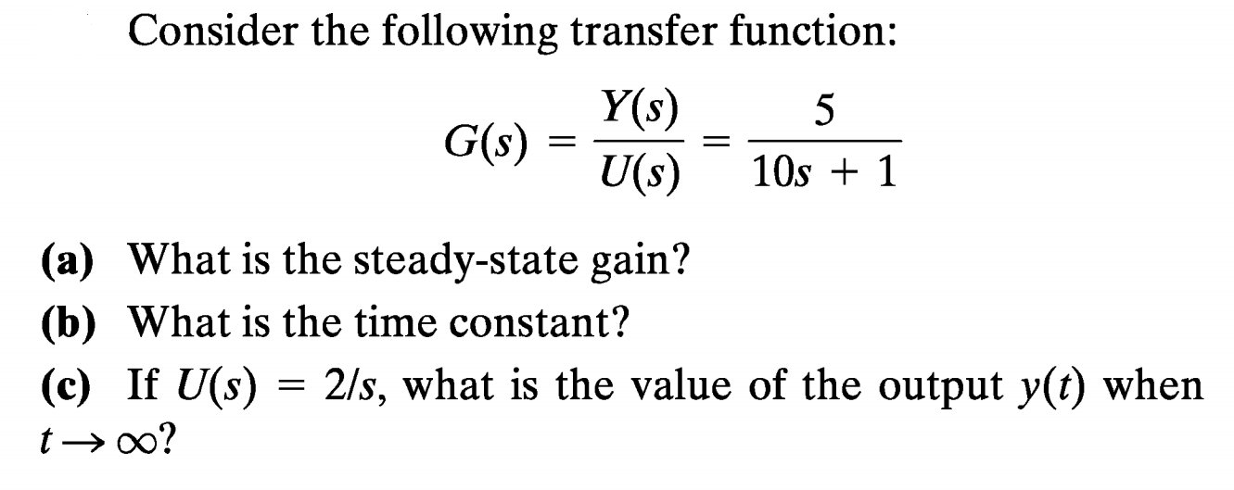
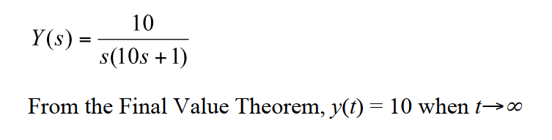
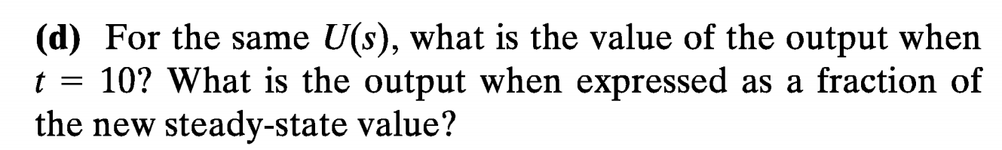
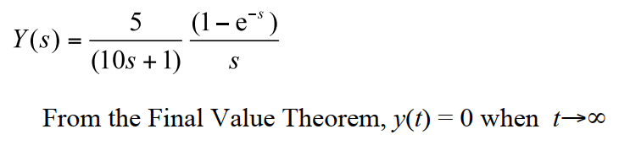
3
K=5
Solution:
Solution:
Solution:

Slide 5
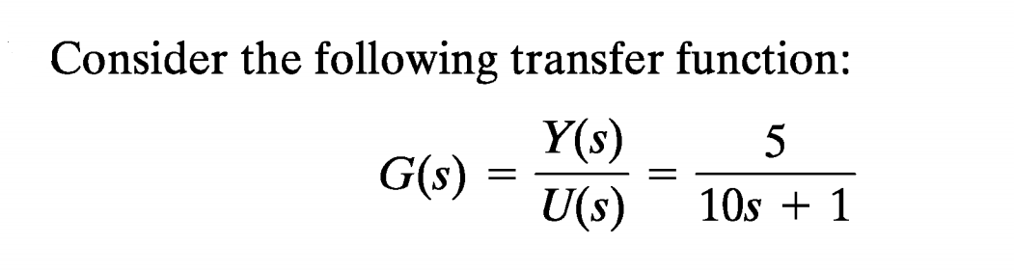
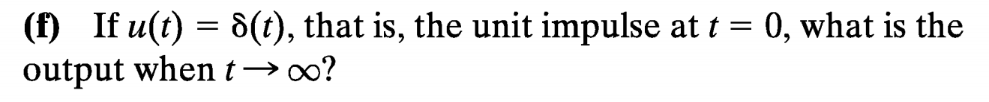
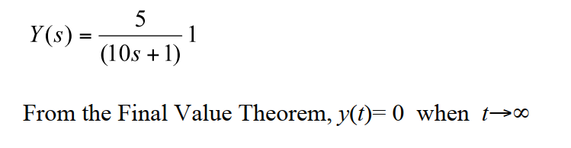
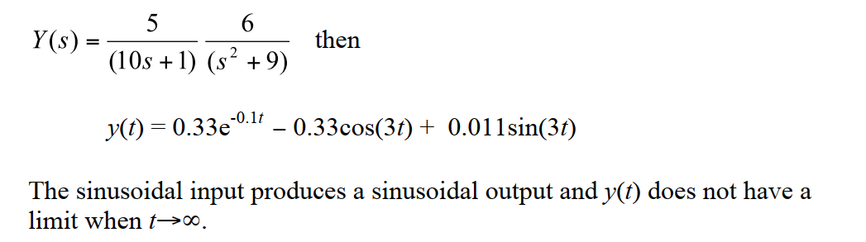
4
Solution:
Solution:

Slide 6
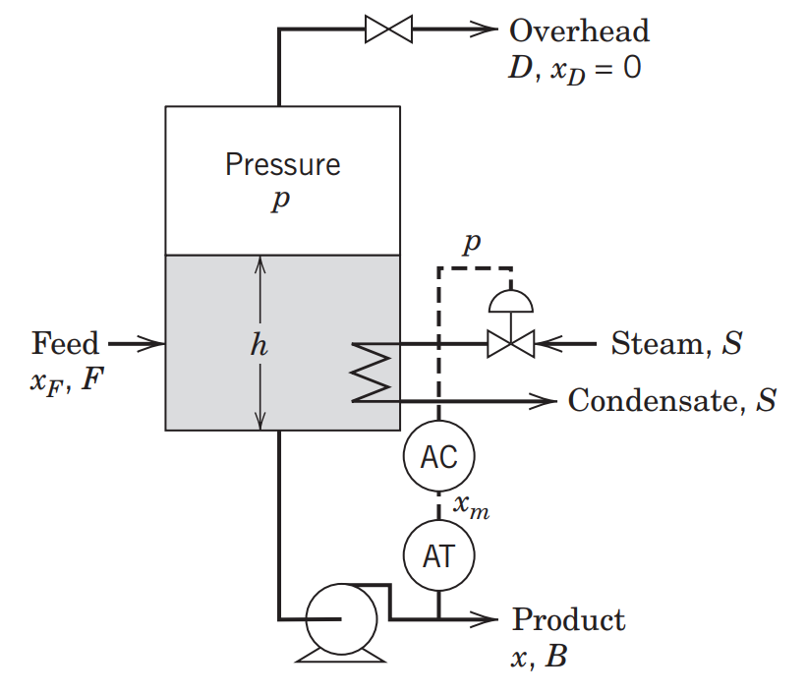
5
A steam-heated evaporator used to concentrate a feed stream by evaporating water is shown in figure below. The mass fraction of solute in the exit stream x is measured and controlled by adjusting the steam ﬂow rate, S.
Questions:
Draw block diagram for this control system
List controlled variable, manipulated variable and possible disturbance variables.
Should fail-close valve or fail-open valve be used to adjust S?
Is the controller AC reverse acting or direct acting?

Slide 7
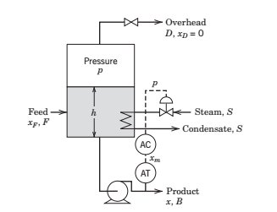
5
Solution:
Since control valve is fail-close, kv>0
Steam flowrate increases, x increases, so
Kp>0
Kc should be positive to satisfy Kvkpkmkc>0
Thus, the composition controller should be a reverse acting controller

Slide 8
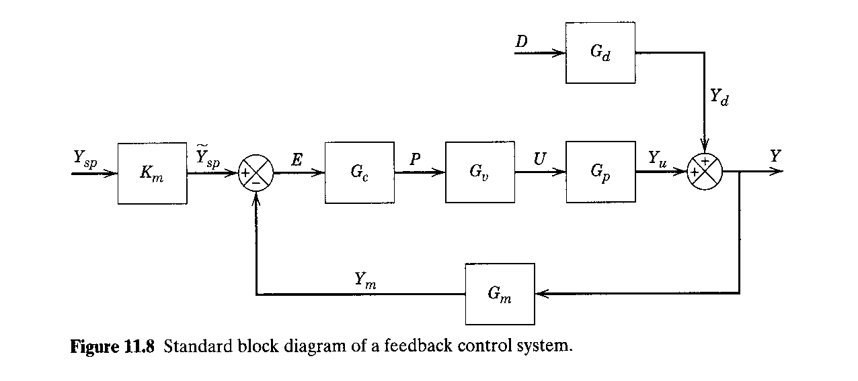
6
Consider a feedback control system:
Using Routh stability method to determine the range of Kc which makes the closed loop control system stable.

Slide 9
6
solution

